Slide 1
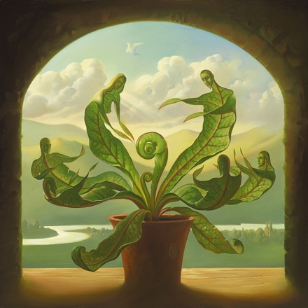
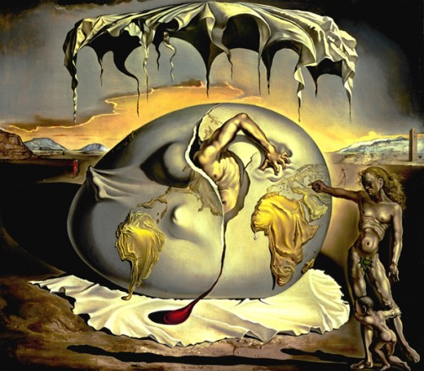
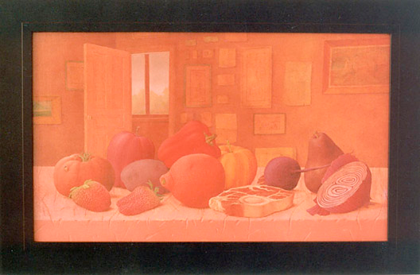
Comparative Study:
Symbolism and Meaning
Introduction: My comparative study looks at symbolism and meaning between three different artists. When I first discovered all three of these artist’s pieces, I never thought of the actual meaning. Going more into depth with them and with a lot of research, I finally figured out the true symbolism behind them and the true meaning behind each symbol. Although all artists may not have the same meaning, they all use the somewhat the same techniques and get the message across by using strong symbolism.
All artists have considerably the same meaning, but they all have different ways of portraying the meanings. Whether it’s about life or death, Vladimir, John and Salvador use different ways of showing their meanings through using different brushstrokes, using colors as symbolism or using their space to make sure the correct thing catches the viewer’s eyes. I want to dig deeper and find the similarities and differences of all artists.

Slide 2
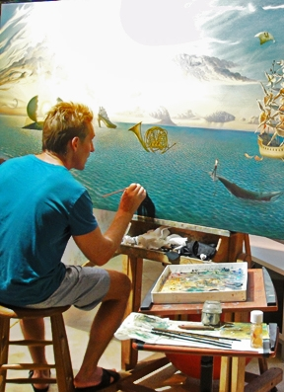
Vladimir Kush
Vladimir Kush is an international surrealist artist who has had galleries in many locations, including:: Lahaina, Maui, California, Las Vegas and New York. At the age of seven, Vladimir Kush received inspiration from renaissance, romanticism, surrealism, famous impressionists and modern artists. Vladimir believes that metaphor in paintings in which he said, “leaves the mind open to grasp onto the hidden likeness of things and events.” The most known metaphor or theme in Kush’s paintings are butterflies, which Kush explains symbolizes “... its ability to fly, its metamorphosis and its weightless quality, the Butterfly is a symbol of the soul, according to many different mythologies.” Kush is involved in many different types of art forms, but the medium Kush uses for paintings is oil paint on either a canvas or a board. Kush explains that moving from Russia to Hawaii has influenced his art to a whole other level. “The world full of colors was now in front of me, feeding the colors of my palette… Here I have become a professional artist.” Kush explains that his youth was trapped in “social realism” and when he came to the United States, Maui has created a new art scene and because of this, anyone who tries to influence Kush’s work is unable to. Other artists that try to create what Kush does lacks experiences and influences they have compared to Kush. “The best time in my work is when the idea and the vision of the future painting is already brought together in my mind, while the canvas is still waiting for the first touch of the brush. It takes only a moment, and I am in the world that I have created myself.”

Slide 3
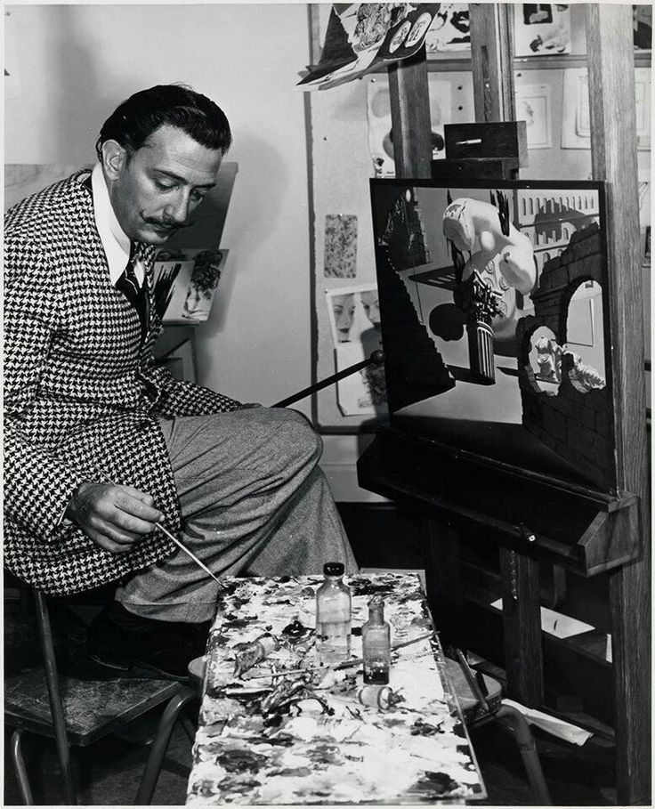
Salvador Dali
Salvador Dali is a well known surrealist artist from the mid-1930’s. Dali’s inspirations were known as Pablo Picasso and Joan Mirró; also in general known as Classical and Renaissance which became obvious through his “hyper-realistic style” and “religious symbolism” that is shown throughout his work. However though, he painted subjects related to Catholic religion that he found a way to give it an illusionistic twist similar to his other works. Unlike other artists, he transitioned through different types of style, going from impressionism to surrealism, to his classical period becoming an evolving artist in multiple movements. Dali painted in two mediums; oil paint and watercolor paint on canvas.
“Surrealism is destructive, but it destroys only what it considers to be shackles limiting our vision.” Dali was known for using a variety of methods, one of them being "Paranoiac-Critical Method" which is described as a mental exercise of accessing the subconscious part of the mind to have an artistic inspiration. Dali is not only known for using this method to realize that dreams and imagination were just in his mind, but using this to change the world to what he wanted, not necessarily to change how the world was. Dali believed that an artist should focus on cultivating a delusion but still being aware in the back of their minds that “control and reason” will be pendant for a period of time. Dali thought this should be what people follow during daily courses of people’s lives and when interacting with others.

Slide 4
John Wilde
John Wilde is an artist born in Milwaukee who got his degree at UW- Madison before he served in the war. John Wilde’s inspiration or style of his work is described as a modern extension of traditional realistic styles. He also paints in a way of Italian Renaissance art mixed with fantasy art connecting with Northern European Traditions. A personal inspiration of Wilde’s was a man named Marshall Glasier who was an artist born in Wauwatosa. Because of the originality of John Wilde’s renderings of living forms, his art is put into the category of surrealism and magic realism. Wilde is mostly known for creating art that expresses love and death. John Wilde’s medium is a use of oil on wood, canvas, or board. Wilde used his studio space wisely to develop his common themes for his physical surroundings, as well as using the peace to recreate images from his own imagination. Either this would be the case, or Wilde would go off of sketches he made during the war and bring them back to life with paintings. When Wilde would have to think about what to paint, he would say he would have to be, “alone with my true love, a little (studio) work, a little yard work". He continued by saying, "no one to see, no one around, no nonsense.”

Slide 5
Analysis of “Miracle of Birth” by Vladimir Kush
The “miracle” is emphasized by the structure of the painting that resembles circles in the water. The colors and the lightness of the brushstrokes gives the painting more of a beautiful interpretation of the birth of Christ.
The motif being exposed in this piece is Christ’s birth. This can be proved by the tons of different symbols hidden in the painting.
Symbols in the piece:
The cloud appeared in the background in the shape of an “annunciation dove” which was the act of conception that took place in the virgin’s ear. This can also explain why the dove is near the virgin and none of the other people.
The logo on the flower pot in the shape of a IHS (Iesus Hristos Soter) which means Jesus Christ Conquers and this is also apart of the Catholic religion.

Slide 6
Techniques of “Miracle of Birth” by Vladimir Kush
Vladimir uses the shape of a dove to make the meaning deeper and separated it from the other white clouds to make sure there is a clear view of it to deeper the meaning. Kush also makes the shape of a circle to show that the baby is the main meaning of the piece.
The scenery of the background gives you a happy feeling because it looks peaceful and calming to the viewer.
The colors in the painting are mostly cool colors, but he makes the green of the leaves and/or people more vivid to catch the viewer’s attention.
Kush uses the space of the painting to put the plant in the center of it to make sure that it is the main focus.

Slide 7
Analysis of “Geopoliticus Child Watching the Birth of the New Man” by Salvador Dali
This piece was made to express America’s newfound importance that America held not only for Dali, but for the world.
Symbolism:
The man breaking out from the egg symbolizes that the world is emerging out of a “new nation” and America is gesturing a global transformation.
Africa and South America are detailed on the egg to represent the importance of the “third world.”
Europe is being crushed in the man’s hands, displaying that it’s decreasing its place as an international power.
The draped clothes below and above the egg is a representation of the placenta of a new nation which leads to the drop of blood symbolizing it can be born with a lot of agony and suffering.
The older woman on the right is pointing out the change happening and the child having a longer shadow than the woman represents a different age in the world.

Slide 8
Techniques of “Geopoliticus Child Watching the Birth of the New Man” by Salvador Dali
Dali balances out his background to his foreground by using dark colors in the background to contrast the foreground and lead the viewer's focus deeper into the center, which is the most significant part.
The woman on the right’s form makes you think harder about the meaning of the piece and why she’s so thin that her bones are showing.
The deep tone of the blood dripping from the egg makes the meaning deeper and shows the agony and suffering to a deeper extent.

Slide 9
Analysis of “Studio Still Life– Red” by John Wilde
Wilde often uses fruit to symbolize fertility in his works.
The warm colors and the light that surrounds the table evoke feeling of autumn and harvest.
A symbol in this piece is the big portion of meat in the center that stands out from all of the fruit.
The meat symbolizes the tradition of memento mori which means “remember that you can die”
Memento mori is a Latin theory and practice of reflection on mortality which is the overall meaning of this piece.
This relates to many of Wilde’s other work because he tends to have death present in most of his pieces.

Slide 10
Techniques of “Studio Still Life– Red” by John Wilde
Wilde makes the entire painting’s colors very hazy and the brush strokes are delicate, the lines aren’t too harsh.
The colors of the fruit are rich and bright, showing the meaning of fertility.
Wilde makes the meat in the center of the fruit, but doesn’t make the color noticeable. This is done to make the viewer look closely at the piece and make the meaning hidden in plain sight to see if people actually pay attention to his piece.

Slide 11
Kush
The purpose of this work is to express America and it’s newfound importance and how hard it was to get out of it.
The purpose of this work is about Christ being born and overall how birth is an amazing thing.
Dali
Important messages being portrayed
There is tons of hidden symbolism hidden
They use space to make sure the most important thing is visible and in the center.
Their shading gives
their piece a 3d
effect
Kush uses softer brushstrokes and he makes a use of lighter and cool colors.
Dali uses more harsh brushstrokes, he creates a use of darker and warm colors.
The figures are not realistic, they’re in plant form and the figures make you feel more calm and relaxed because of how soothed they appear.
The figures are realistic, they make you feel tense because of the emphasis on bone structures and the stress that you can see through their look or movement.
The background is really dark and depressing (darker colors, rough mountains)
The background looks really joyous (fluffy clouds, smooth river, soft mountains)

Slide 12
Wilde
Kush
The main purpose of this piece is death
The main purpose of this piece is birth
The use of soft brush strokes.
Uses colors to deepen the meaning
He makes the use of warm colors and uses the colors in a sad and hazy manner.
He makes the use of cool colors in and uses the colors in a really calm and relaxing manner.
A still life that Wilde actually set up and painted from.
Kush made this from imagination and is a bit more surrealist than Wilde’s.
Uses shapes based on the looks of the fruit and meat.
Uses shapes for symbolism and meaning.
Uses strictly fruit and meat to create a message.
Makes the leaves to create people that make you realize a deeper meaning.

Slide 13
Wilde
The main purpose of this piece is death and how you can’t get away from death.
The main purpose of this work was to express America and it’s newfound importance.
Dali
Uses warm colors for stronger meaning
Using certain objects for symbolism
Using the warm colors in a sad and hazy manner, brushstrokes are softer.
Using warm colors in a depressing and extreme manner, brushstrokes are harsher.
Using shapes based on what he sees in the still life.
Using shapes to show a deeper meaning and to make meaning more obvious.
The background and foreground are the same kind of hazy red color.
The background is much darker and more neutral whereas the foreground is brighter but still dark.

Slide 14
Conclusion: Deeper research of symbolism
Annunciation Dove:
Symbolizes the act of conception that took place in the Virgin’s ear.
Logo on flower pot, IHS
“Jesus savior of mankind”
This symbol was used to show your own devotion to the lord.
Continents:
The man gripping Europe to show how it is decreasing in power.
Africa and South America are emphasized for the third world.
Drop of blood:
Showing change can be done if there is a lot of agony and suffering.
Young child large shadow:
A different age in the world.
Meat:
Based on memento mori which is based on symbolic reminders of mortality
Emphasized heaven hell and redemption of the soul in the afterlife.
This is used for symbolism in many religions such as Mexican, Buddhism and Islamic culture.

Slide 15
Works cited
http://www.thelongworthgallery.com/#!kush-giclee-art/c234g
http://vladimirkush.com/
http://rusart.ca/history/dali.html
http://www.examiner.com/article/a-conversation-with-surrealist-painter-and-sculptor-vladimir-kush
http://www.hawaiivisitorguideonline.com/maui/edit/ed-kush-MV.html
http://www.theartstory.org/artist-dali-salvador.htm
http://www.people.vcu.edu/~djbromle/modern04/nayefa/
http://www.salvadordali.com/biography/
http://www.encyclopedia.com/topic/Salvador_Dali.aspx
http://www.dalipaintings.net/
http://www.sullivangoss.com/
http://www.mmoca.org/mmocacollects/artists/john-wilde
http://vladimirkush.com/miracle-of-birth-794
http://www.theglobaldispatches.com/articles/symbolism-in-the-annunciation
http://thedali.org/exhibit/geopoliticus-child-watching-birth-new-man/

